Slide 1

VeilMe
Ensuring Our Privacy
Using Adversarial Attacks, We Induce Our Photos With Noise
Mariia Padalko - DS | Nissim Hefetz - DS | Emma Grob -FS | Rommi Englard -FS | Michael Goncharov - DS

Slide 2
Motivation
With the emergence of Advanced AI systems that use face recognition techniques, hiding one’s identity on the internet has become a challenge.

Slide 3

Emphasis on Covid-19
Working Remotely
Working remotely requires sensitive material such as employee pictures to be uploaded to various online working platforms.

Slide 4

Emphasis on Covid-19
Socializing
Social media or different apps require uploading a picture. Interacting with different people can expose your personal life without having a choice if to allow it or not.

Slide 5
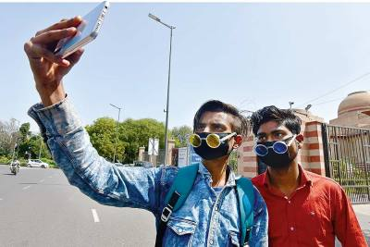
Emphasis on Covid-19
Government Tracking
Even if you leave you leave your phone at home, the government can track our whereabouts through uploaded images taken by others; whether at a party or simply taking an innocent selfie

Slide 6
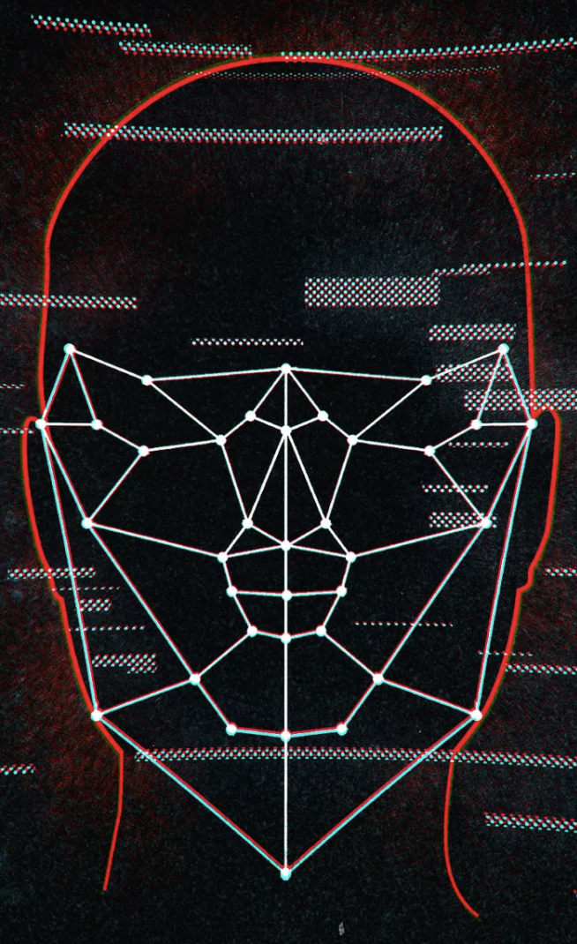
Emphasis on Covid-19
Government Tracking
IBM CEO said in a letter to Congress june 8 2020
IBM will no longer offer, develop, or research facial recognition technology
“IBM firmly opposes and will not condone uses of any [facial recognition] technology, including facial recognition technology offered by other vendors, for mass surveillance, racial profiling, violations of basic human rights and freedoms, or any purpose which is not consistent with our values and Principles of Trust and Transparency”

Slide 7

Our Mission
Our Mission is to ensure people’s freedom and safety by limiting the ability to track you from your images on the internet. We plan to keep your employer, your stalker or even the government out of your personal life so that you can live worry free.

Slide 8


Demo

Slide 9



Before - After

Slide 10


import face_recognition
Hey, face_recognition!
Is this the same person?
True
Adding noise
False
False

Slide 11



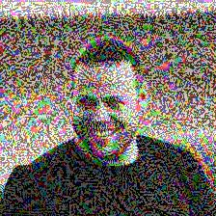
RECOGNIZED
ε=0.1
NOT
RECOGNIZED
ε=0.23
NOT
RECOGNIZED
ε=0.5
But even not readable

Slide 12

Business model
Customer
Individual
Companies in EU
Under GDPR
Apps:
Linkedin
Tinder
Facebook
payment
Free
License + support
Monthly subscription
FR
VeilMe

Slide 13
our next steps
Features | Product
Minimize the level of noise. Add noise only to you in group photos. Detect the edges of a face and add noise only to a person’s face. User can choose the level of noise. User can choose if to upload directly to a third party app (integration with Instagram, FB, etc) | Adding permanent noise to web camera. Suggesting the user to add noise immediately after photographing (integration with Finding vulnerable photos of a user (including group photo) and protecting them.

Slide 14
links
https://arxiv.org/abs/1412.6572 - Explaining and Harnessing Adversarial Examples, I. J. Goodfellow, J. Shlens, C. Szegedy
https://pytorch.org/tutorials/beginner/fgsm_tutorial.html - Good example of FGSM attack with MNIST datasest
https://www.tensorflow.org/tutorials/generative/adversarial_fgsm - FGSM on Object Detection NN.

Slide 15


